Slide 1
Lab 4
HPC Introduction
Convolutional Neural Network I
Yuxuan Chen
Feb 15, 2024

Slide 2
Steps of Launching HPC
Install VPN (https://www.nyu.edu/life/information-technology/infrastructure/network-services/vpn.html )
Open Demand: Web-based Graphical User Interface
Create easier access to HPC systems.
Interactive Apps such as Jupyter Notebook, and RStudio
https://ood.hpc.nyu.edu
Please have a look of the HPC instruction pdf for more details

Slide 3
Convolution Operation
Convolution is the simple application of a filter to an input that results in an extracted feature
The filter(s) scan through the image to result in a map(s) of features called feature map(s).
In this visual shown, a 3*3 filter convolves over a 5*5 image & outputs a feature map of 3*3.

Slide 4
Convolution Operation
e.g. At each position, you multiply the overlapping values of the filter and the input signal and sum up these products

Slide 5
Convolution Operation
e.g. At each position, you multiply the overlapping values of the filter and the input signal and sum up these products

Slide 6
Convolution Operation
Why it is useful? Extracting local features
E.g. detecting edges

Slide 7
Convolution Operation
Why it is useful? Extracting local features
E.g. detecting edges
Edge Detected

Slide 8
Convolution Operation
Why it is useful? Extracting local features
E.g. detecting edges
Convolutional Neural Network is learning the value of these filters automatically

Slide 9
Padding
Conv operation naturally shrinks the size of the input

Slide 10
Padding
Conv operation naturally shrinks the size of the input
Maintain Dimensionality

Slide 11
Padding
Conv operation naturally shrinks the size of the input
Maintain Dimensionality

Slide 12
Padding
Conv operation naturally shrinks the size of the input
Maintain Dimensionality
Edge & Corner Information Preservation

Slide 13
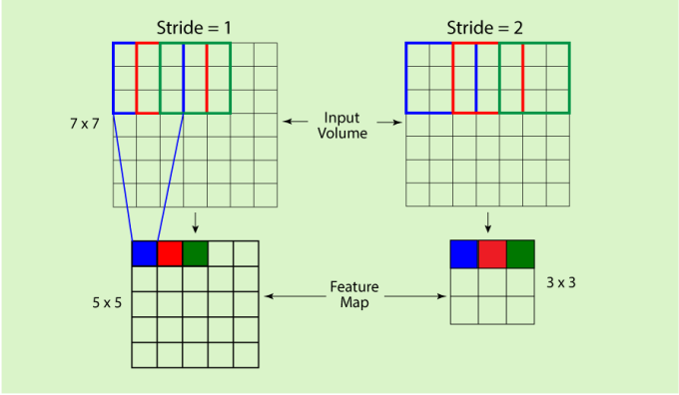
Stride
the length of the step the filter takes while moving across the input
As the stride increases, the resulting output will be smaller

Slide 14
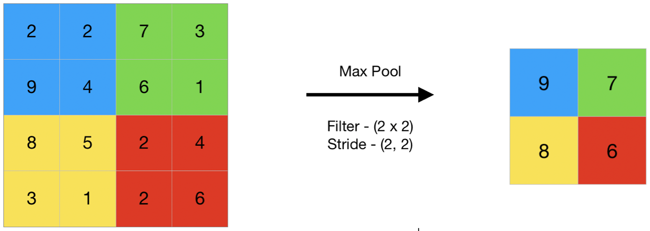
Pooling
The pooling operation involves sliding a two-dimensional filter over each channel of feature map and summarising the features lying within the region covered by the filter
Three types of spatial pooling
Average
Max
Sum

Slide 15
Summary
Convolution: extract essential local features
Padding: maintain dimension of the input, preserve corner and edge information
Pooling: extract the important feature from the feature map
Stride: the length of step for filter to move across the input

Slide 16
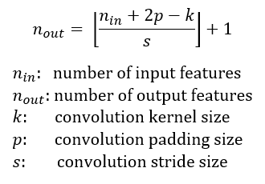
Summary
Convolution: extract essential local features
Padding: maintain dimension of the input, preserve corner and edge information
Pooling: extract the main feature from the feature map
Stride: the length of step for filter to move across the input
Size of output

Slide 17
CNN Architecture

